Slide 1
Java Plays : Eclipse Lab 2
Continuous Integration using DevOps
IBM
ECOD

Slide 2
AGENDA
Purpose of This Lab
Step 1: Fork DevOps Services Project
Step 2: Configure and Run Build and Deploy Pipeline
Step 3: Test App with Postman
Step 4: Modify Code in DevOps
Step 5: Push to Trigger Pipeline
Step 6: Test App with Postman
Summary
Java Plays: Continuous Integration using DevOps

Slide 3
Purpose of This Lab
In this lab, you will learn how to fork a Project in DevOps, edit code and build using DevOps, and finally deploy the project on Bluemix using DevOps. Everything on Bluemix!
Java Plays: Continuous Integration using DevOps

Slide 4
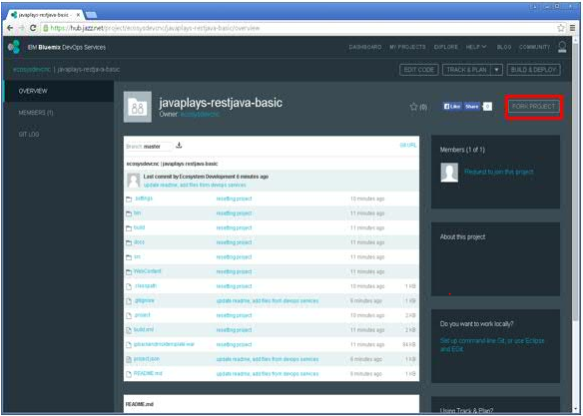
Step 1: Fork DevOps Services Project
Browse to hub.jazz.net
(https://hub.jazz.net/project/ecosysdevcnc/javaplays-restjava-basic/overview)
Click FORK PROJECT
Java Plays: Continuous Integration using DevOps

Slide 5
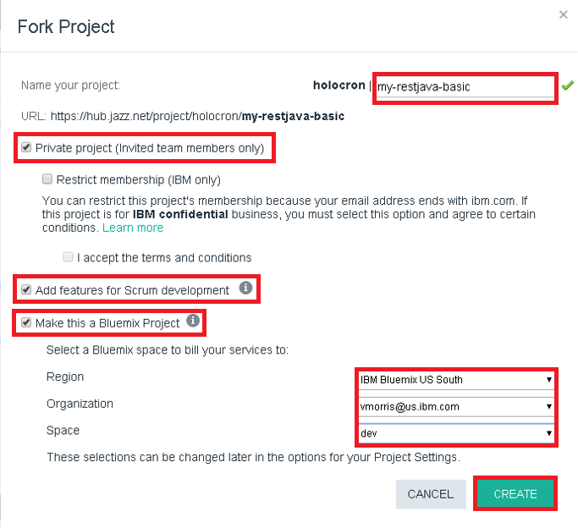
Enter Project Name
Check the following checkbox:
  Private project
  Add features for Scrum development
  Make this a Bluemix Project
Select Region, Organization and Space
Click CREATE
Java Plays: Continuous Integration using DevOps

Slide 6

Success Message
Java Plays: Continuous Integration using DevOps

Slide 7
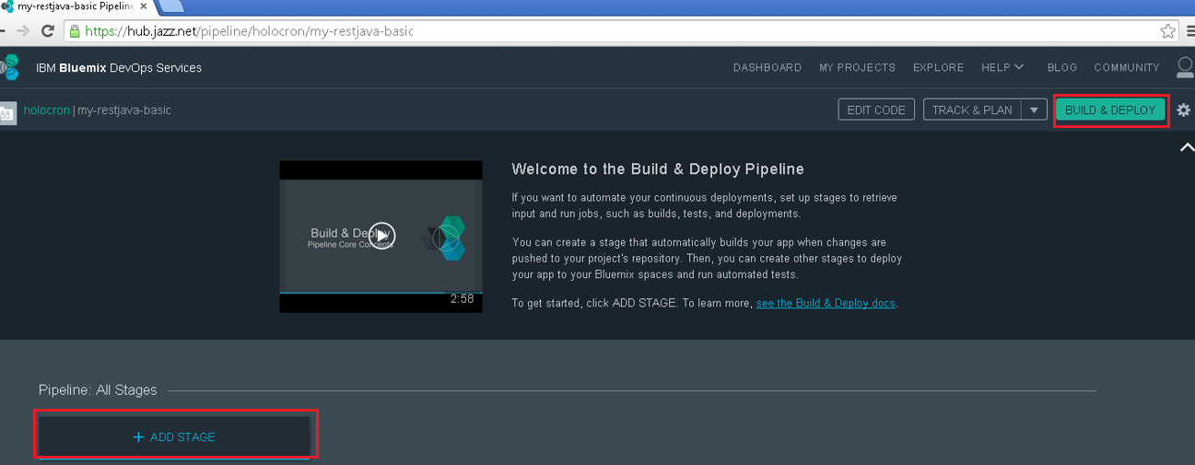
Step 2: Configure and Run Build and Deploy Pipeline
To create build and deploy stage
Click BUILD & DEPLOY
Click ADD STAGE
Java Plays: Continuous Integration using DevOps

Slide 8
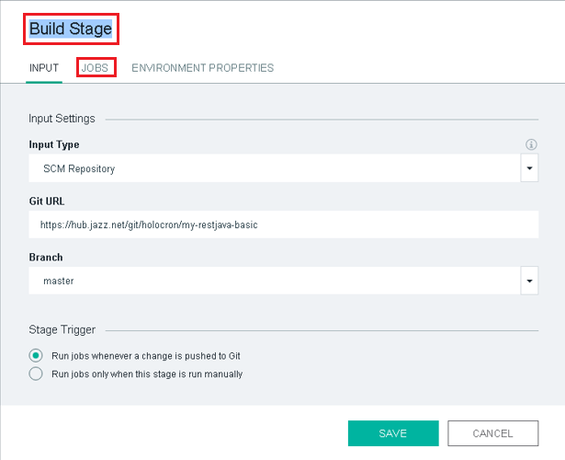

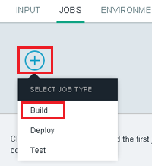
BUILD STAGE
Enter Stage name
Click JOBS tab
Click ADD JOB
Select Build
Java Plays: Continuous Integration using DevOps

Slide 9
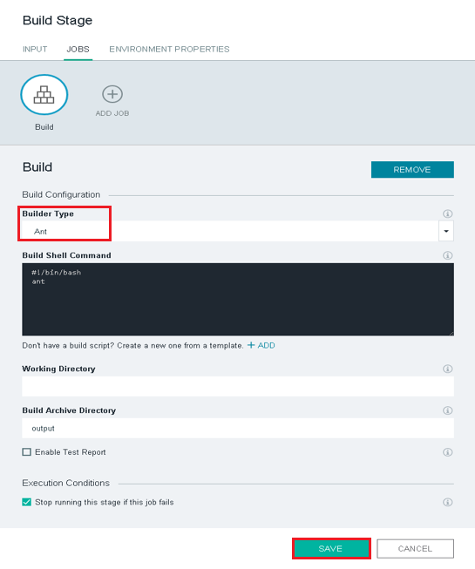
BUILD STAGE (Continue)
Choose ANT for Builder Type
Click SAVE
Java Plays: Continuous Integration using DevOps

Slide 10
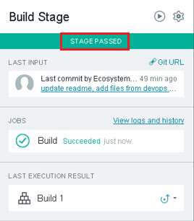
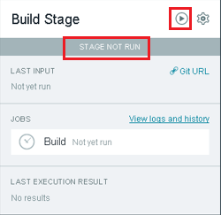
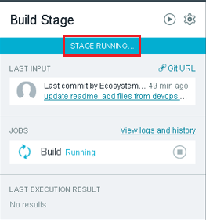
RUN BUILD STAGE
See the Build Stage at the pipeline
Click (Run Stage Icon)
Observe Stage Status change from Stage Not Run > Stage Running > Stage Passed
Java Plays: Continuous Integration using DevOps

Slide 11
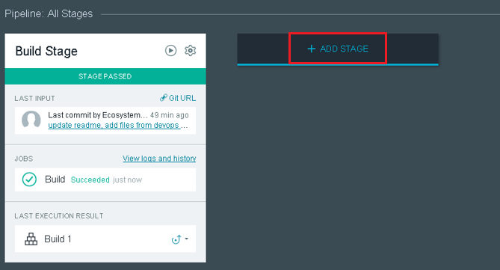
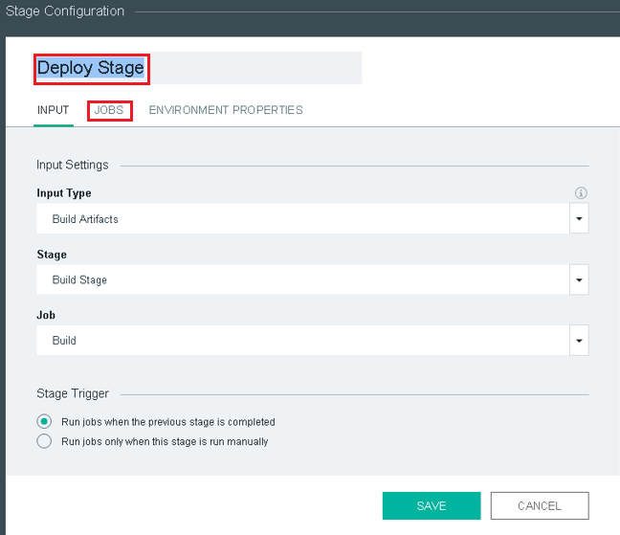
DEPLOY STAGE
At the Pipeline page, click ADD STAGE
Enter Stage name
Click JOBS tab
Java Plays: Continuous Integration using DevOps

Slide 12
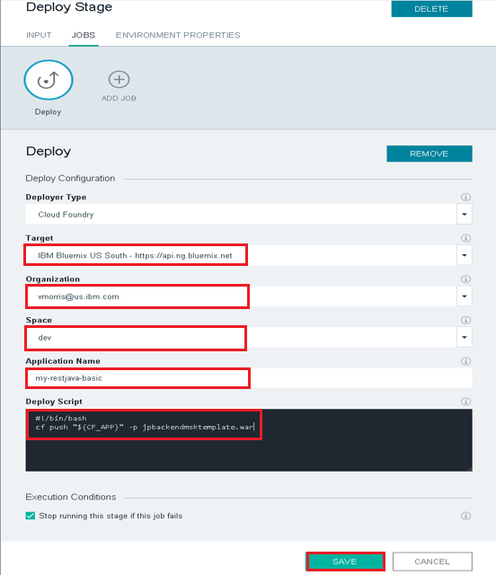
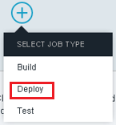
DEPLOY STAGE (Continue)
Click ADD JOB
Select Deploy
Verify the following
  Target
  Organization
  Space
  Application Name
Edit the Deploy Script
(cf push “${CF_APP}” –p jpbackendmsktemplate.war)
Click SAVE
Java Plays: Continuous Integration using DevOps

Slide 13
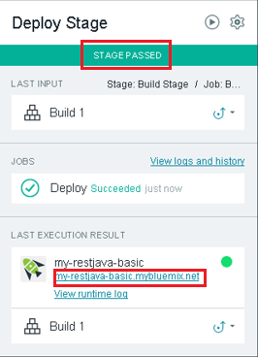
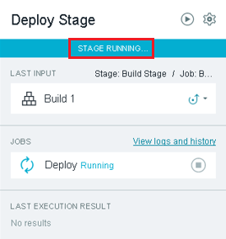
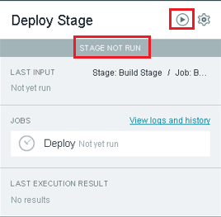
RUN DEPLOY STAGE
See the Deploy Stage at the pipeline
Click (Run Stage Icon)
Observe Stage Status change from Stage Not Run > Stage Running > Stage Passed
Click on the link <your hostname>.mybluemix.net to access the
deployed application
Java Plays: Continuous Integration using DevOps

Slide 14
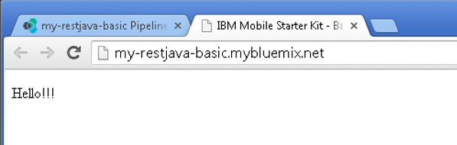
Success page
Java Plays: Continuous Integration using DevOps

Slide 15
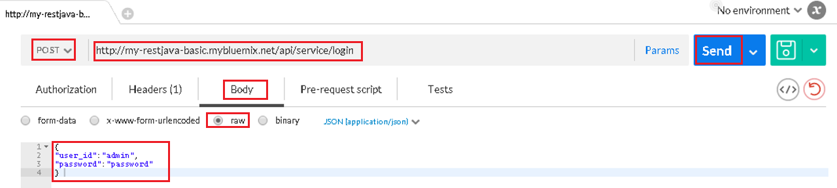
Step 3: Test App with Postman
Open Postman extension page in Chrome browser
Change to POST method
Enter http://<your hostname>.mybluemix.net/api/service/login
Click Body tab
Select raw
Enter the following
  {
  “user_id”: “admin”,
  “password”: “password”
  }
Click Send
Java Plays: Continuous Integration using DevOps

Slide 16
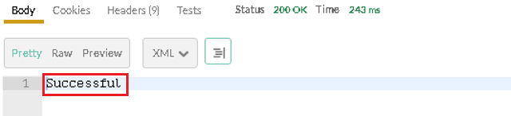
Success message
Java Plays: Continuous Integration using DevOps

Slide 17
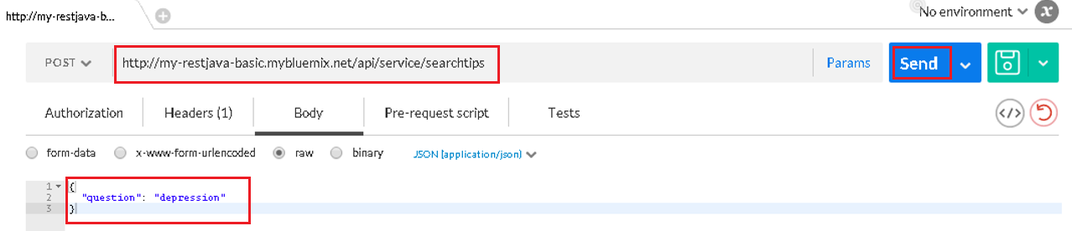
Change url to http://<your hostname>.mybluemix.net/api/service/searchtips
Enter the following
  {
  “question”: “depression”
  }
Click Send
Java Plays: Continuous Integration using DevOps

Slide 18
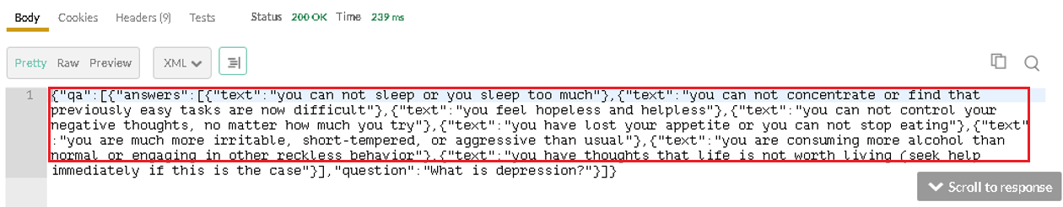
Success message
Java Plays: Continuous Integration using DevOps

Slide 19
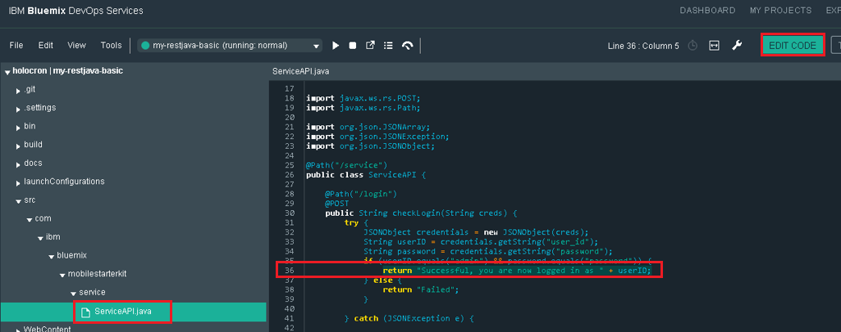
Step 4: Modify Code in DevOps
Click EDIT CODE
Go to src > com > ibm > bluemix > mobilestarterkit > ServiceAPI.java
Edit line 36 to change the success message returned during Postman API POST call
Save the changes
Java Plays: Continuous Integration using DevOps

Slide 20
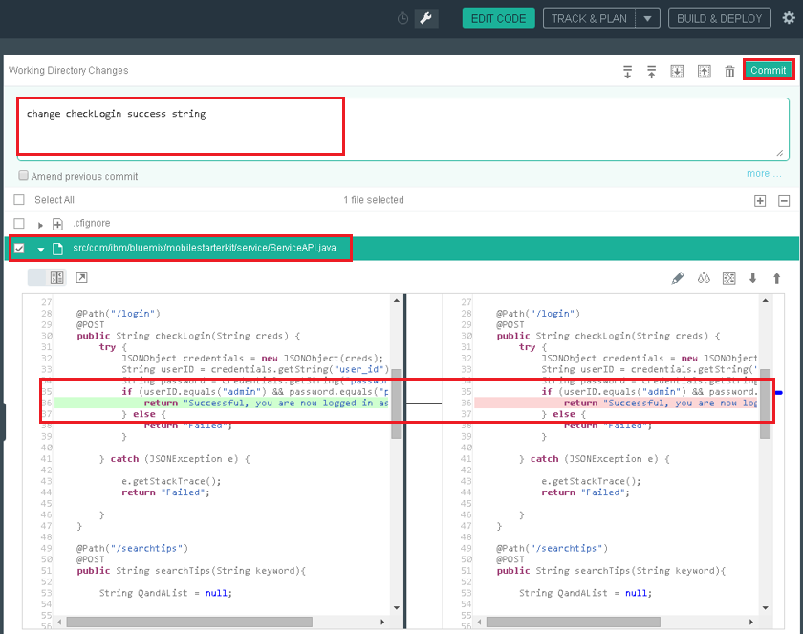
Click Git Repository icon
View and compare before and after changes
Add commit message
Click Commit
Java Plays: Continuous Integration using DevOps

Slide 21
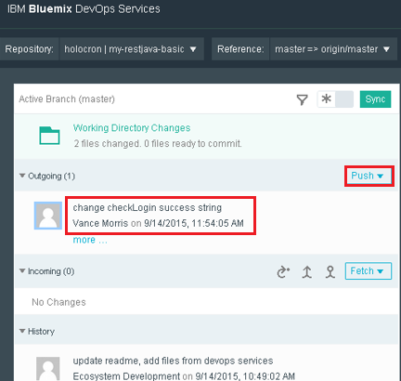
Step 5: Push to Trigger Pipeline
Click Push
Success message
Java Plays: Continuous Integration using DevOps

Slide 22
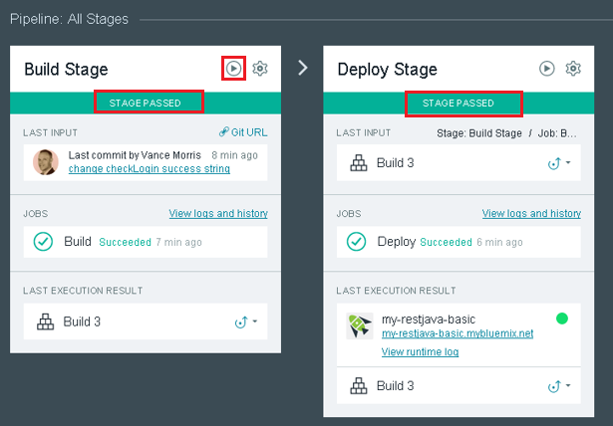
Click BUILD & DEPLOY
On the Build Stage, click (Run Stage button)
Wait till you see both Build Stage and Deploy Stage with status STAGE PASSED
Java Plays: Continuous Integration using DevOps

Slide 23
Step 6: Test Modified App with Postman
Open Postman extension page in Chrome browser
Change to POST method
Enter http://<your hostname>.mybluemix.net/api/service/login
Click Body tab
Select raw
Enter the following
  {
  “user_id”: “admin”,
  “password”: “password”
  }
Click Send
Java Plays: Continuous Integration using DevOps

Slide 24
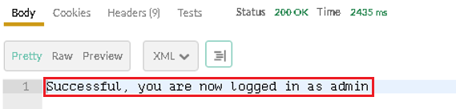
Success message
Java Plays: Continuous Integration using DevOps

Slide 25
Summary
In this lab, you learned how to fork a Bluemix project from an existing one, to create the build and deploy stage, to edit the project using DevOps service, to commit and push the changes.
The entire Java application development and deployment cycle can be implemented on a single platform!
Java Plays: Continuous Integration using DevOps

Slide 26
This ends the Eclipse Lab 2 Build and Deploy Java Application on Bluemix Server.
Thank you !
Java Plays: Continuous Integration using DevOps

